Slide 1


What is the population of India?
01

Slide 2
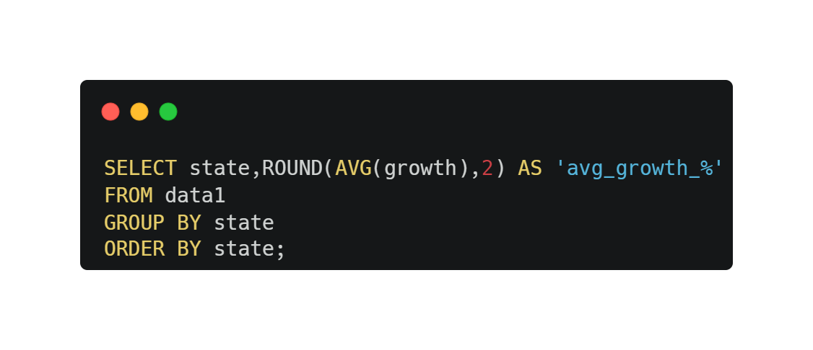
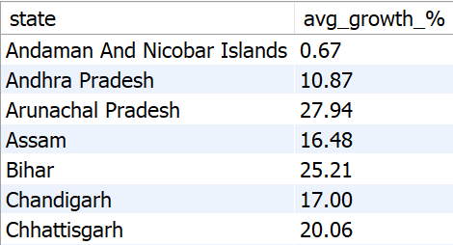
What is the average growth rate for each state?
02

Slide 3
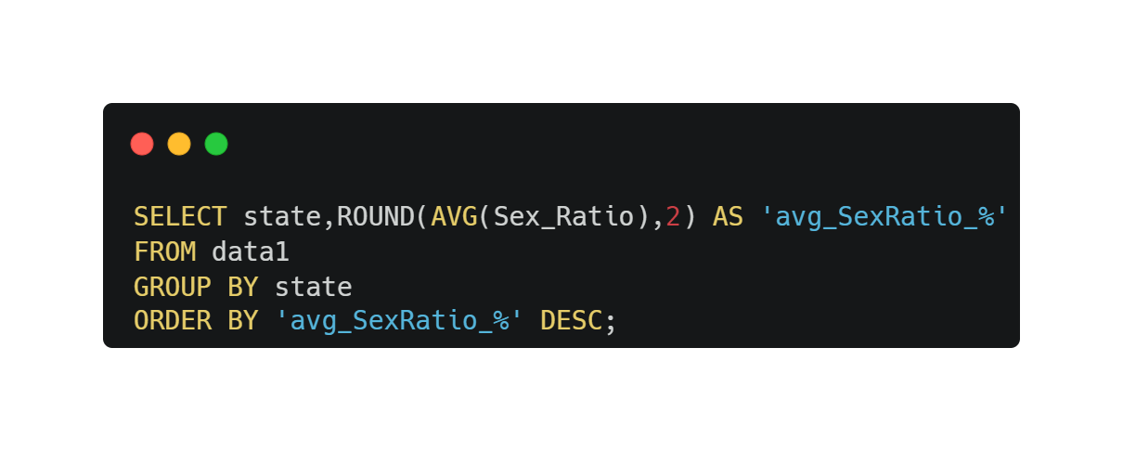
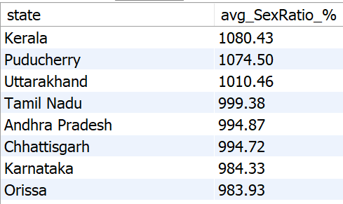
What is the average sex ratio for each state?
03

Slide 4
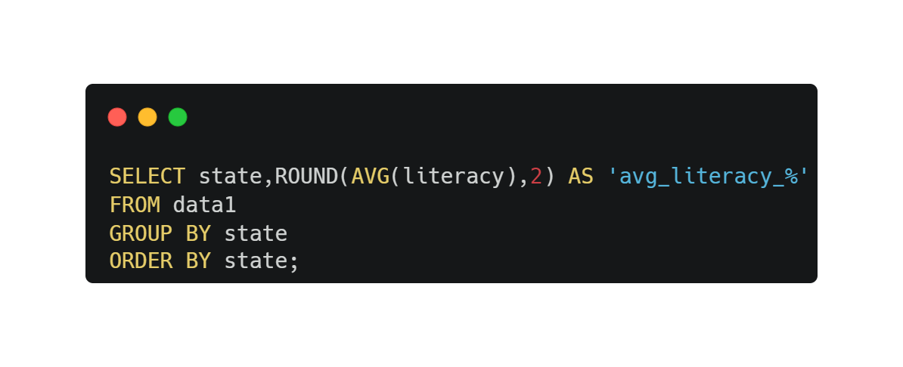
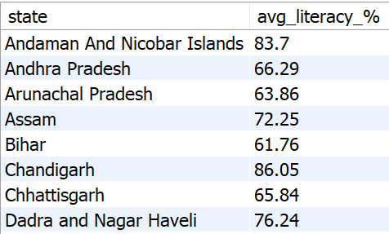
What is the average literacy rate in each state?
04

Slide 5
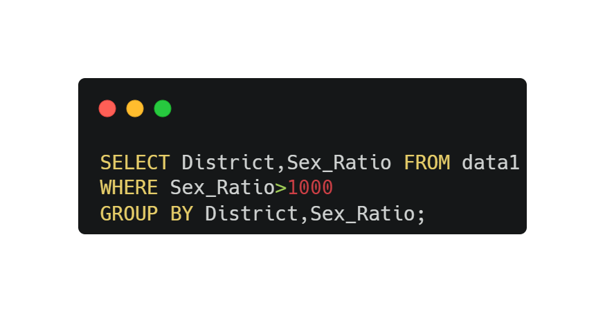
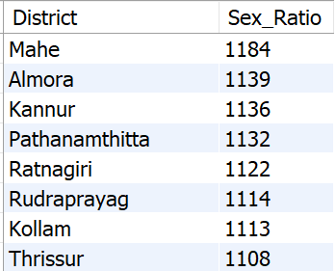
How many districts have a sex ratio above 1000?
05

Slide 6
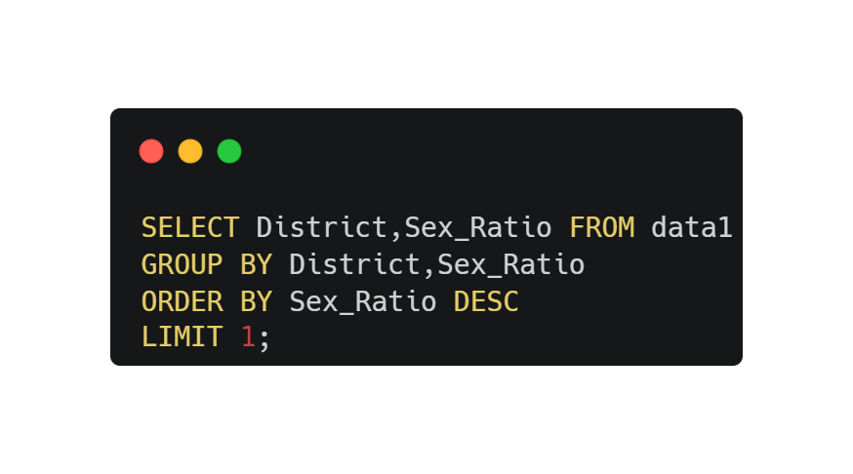

What is the maximum sex ratio recorded among all districts?
06

Slide 7
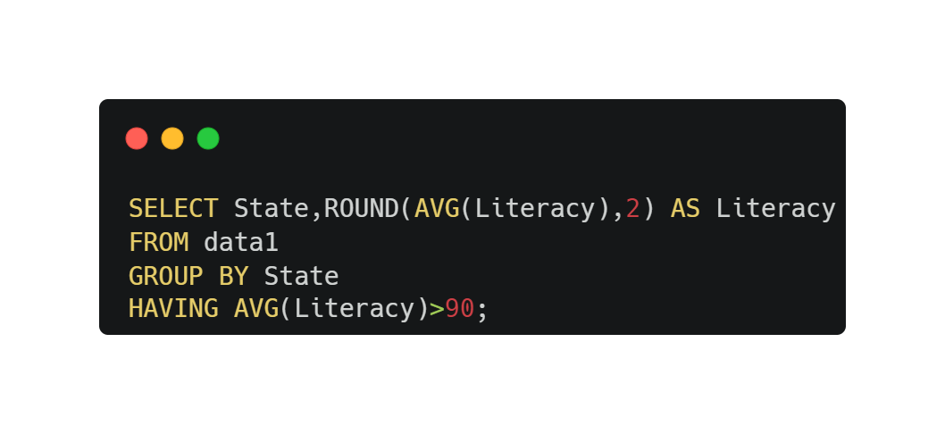

What are the states with an average literacy rate higher than 90%, and what are their average literacy rates?
07

Slide 8
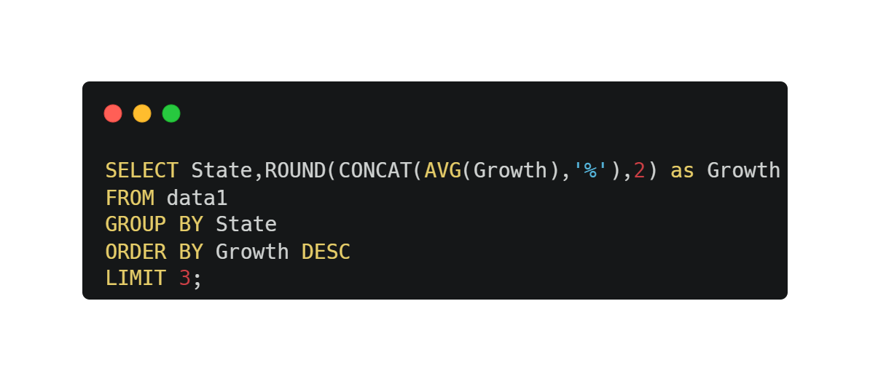
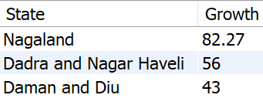
What are the top 3 states with the highest growth ratio?
08

Slide 9
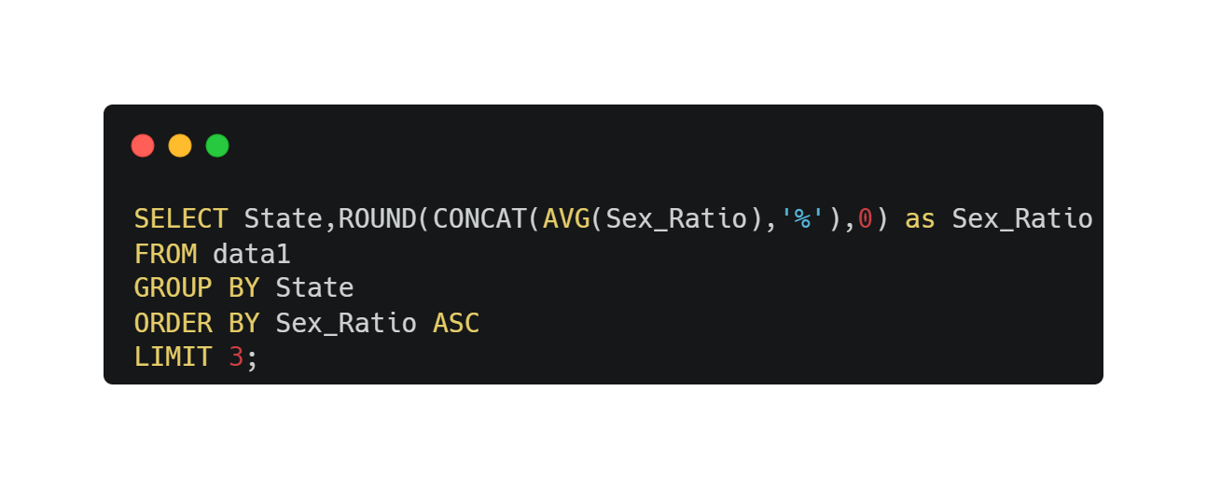
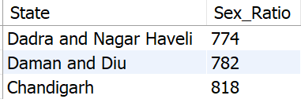
What are the bottom 3 states with the lowest sex ratio?
09

Slide 10
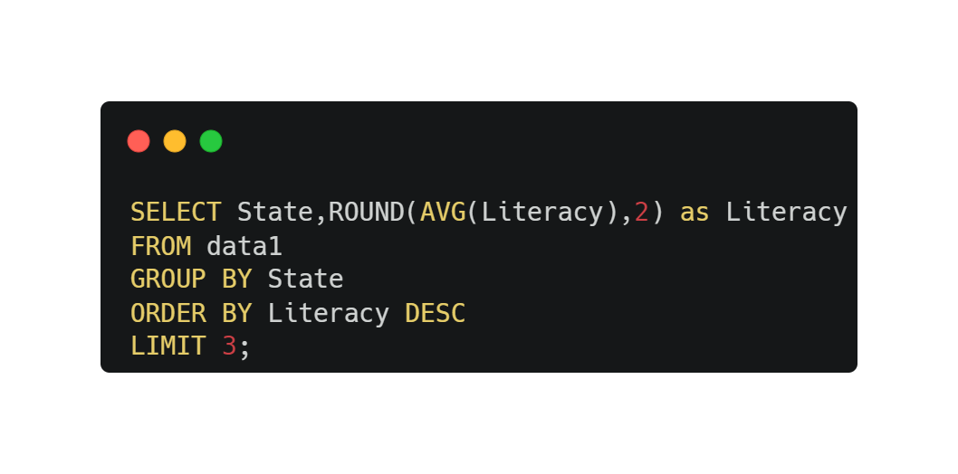
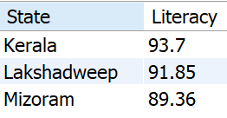
What are the top 3 states with the highest average literacy rates?
10

Slide 11

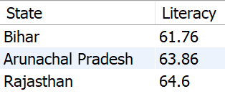
What are the bottom 3 states with the lowest average literacy rates?
11

Slide 12
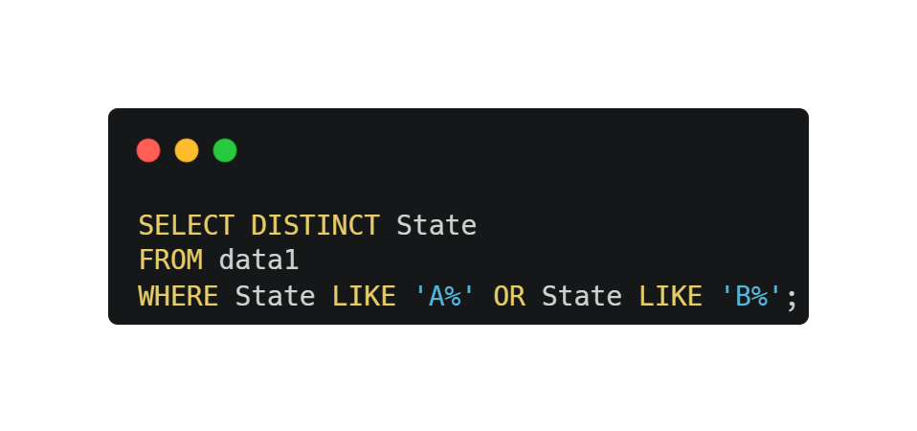
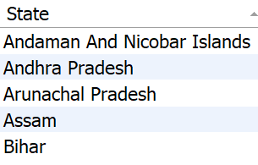
What are the states starting with the letter 'A' or 'B'?
12

Slide 13
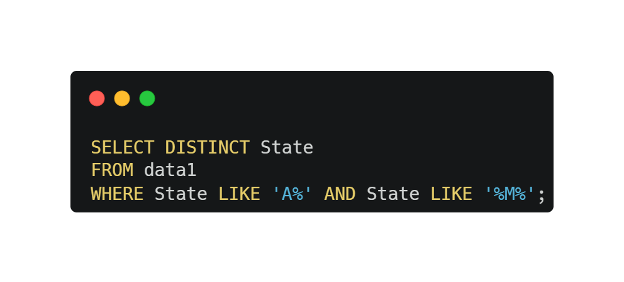
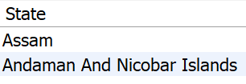
13 What are the states starting with the letter 'A' and containing the letter 'M'?
13

Slide 14
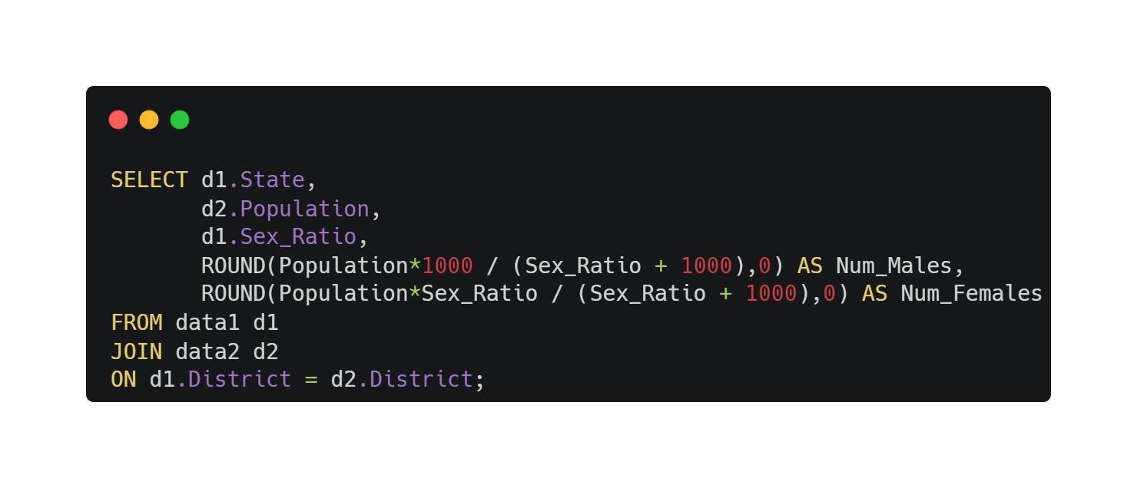
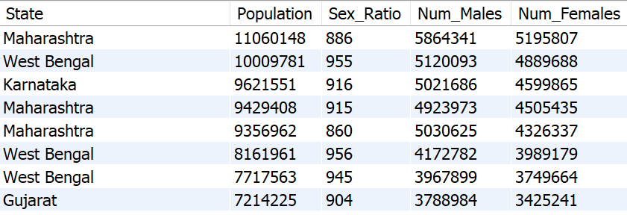
What is the total number of males and females?
14

Slide 15
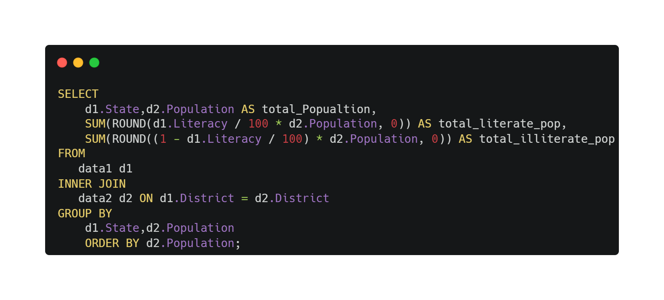
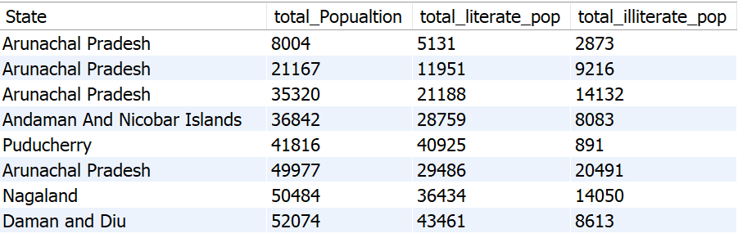
Calculates the total number of literate and illiterate people for each state
15

Slide 16
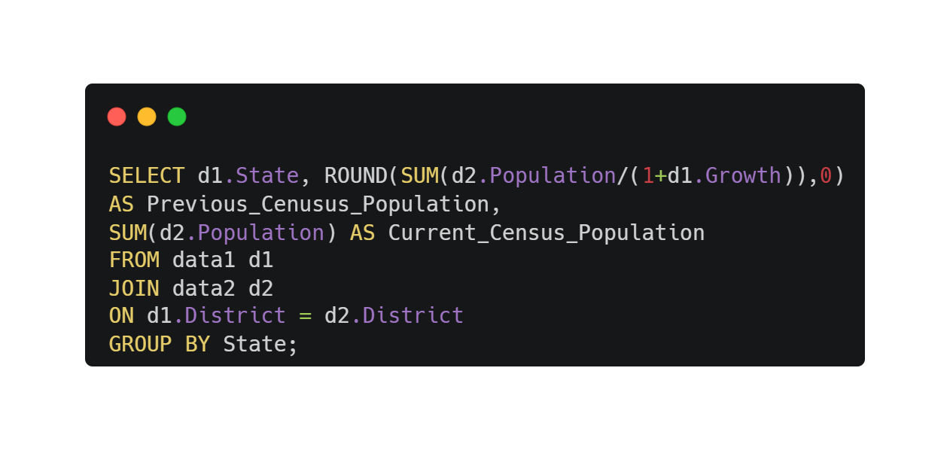
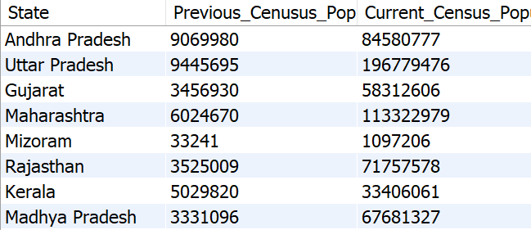
What is the population in the previous census versus the current census-- for each state?
16

Slide 17
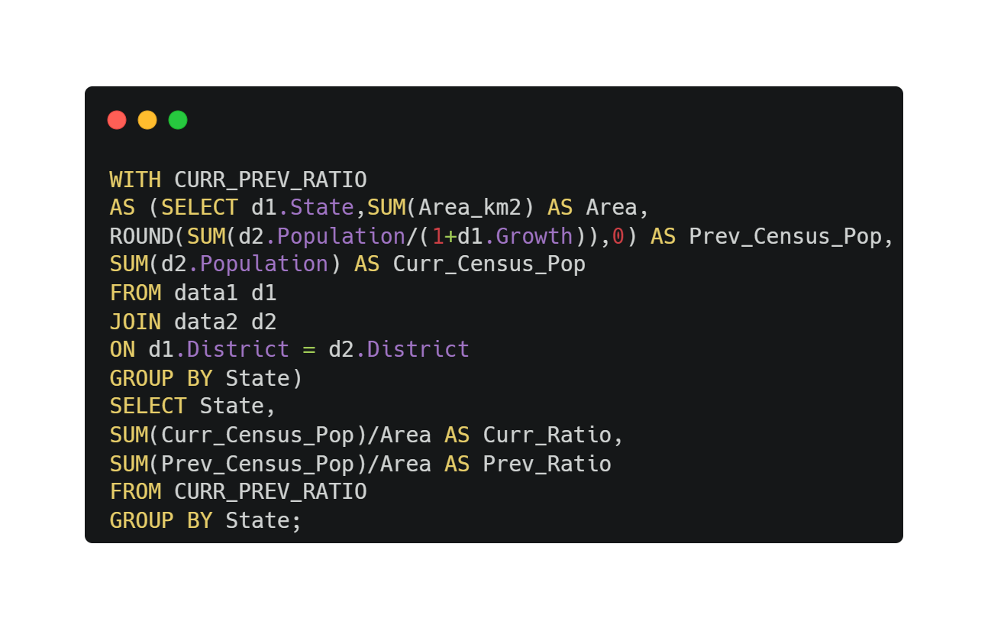
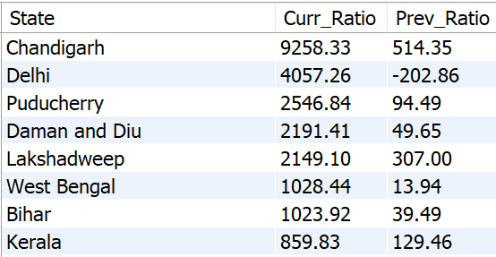
17 What is the population versus area ratio for both the previous and current census?
17

Slide 18
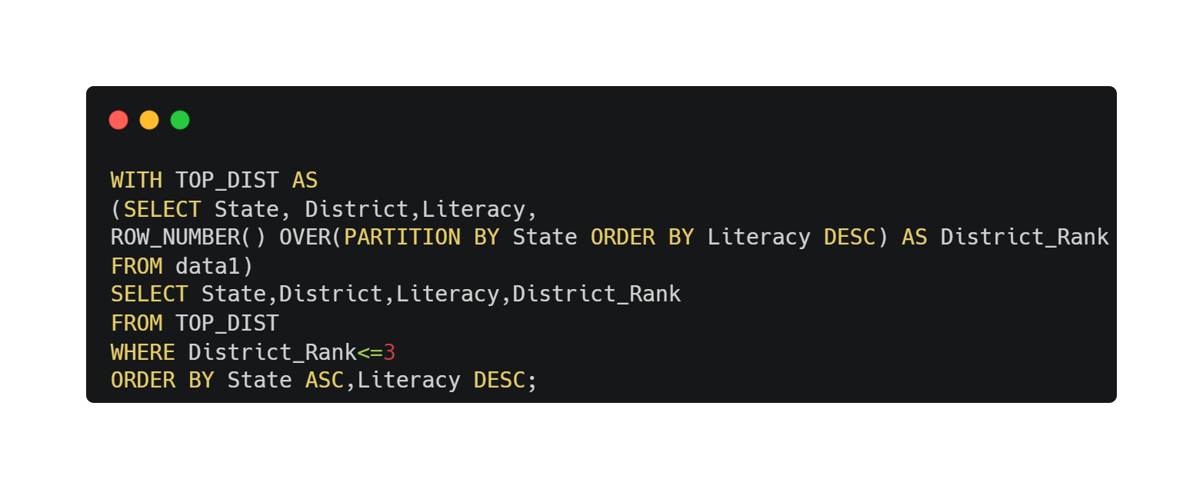
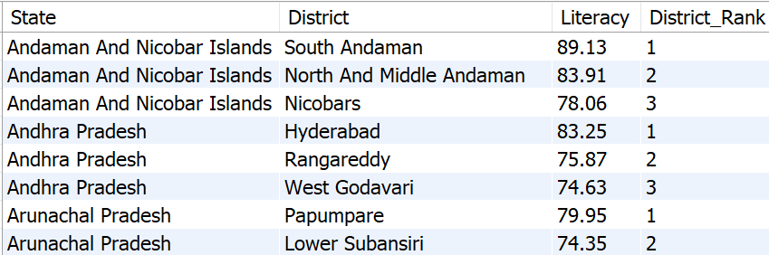
Output the top 3 districts from each state with the highest literacy rate.
18

Slide 19
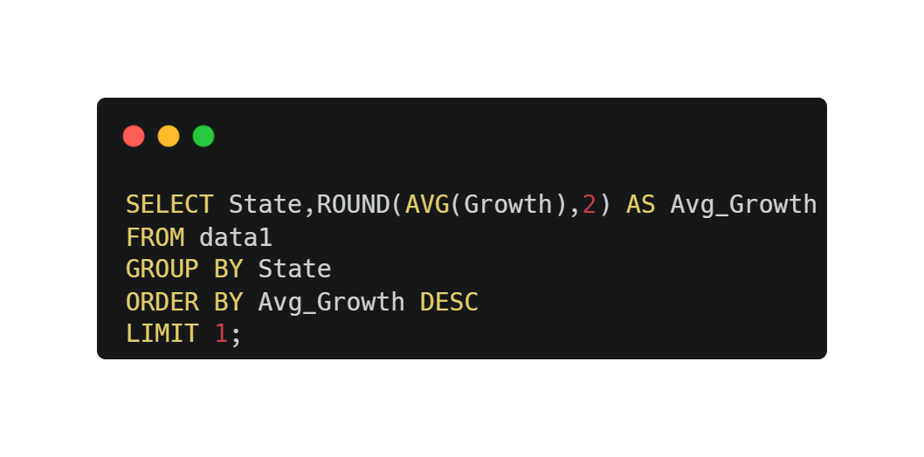

Which state has the highest average growth percentage?
19

